Slide 1

ITU Digital Consumer Forum 2019
Theme - Powering digital Africa through data protection, consumer privacy, trust and security
29-30 JULY, 2019
Mbabane, Eswatini
Introduction and objectives of the workshop
Anne Rita Ssemboga
Program Officer
Regional Office for Africa
Telecommunication Development Bureau
International Telecommunication Union

Slide 2
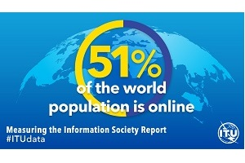
Introduction
The potential of the digital economy continues to grow
  51% of population on line equivalent to billion
  More that 5.2 billion active mobile broadband subscriptions worldwide at the end of 2018;
  In 2017, the mobile industry was estimated to contribute 3.6 trillion equivalent to 4.5% of global GDP- (GSMA)

Slide 3
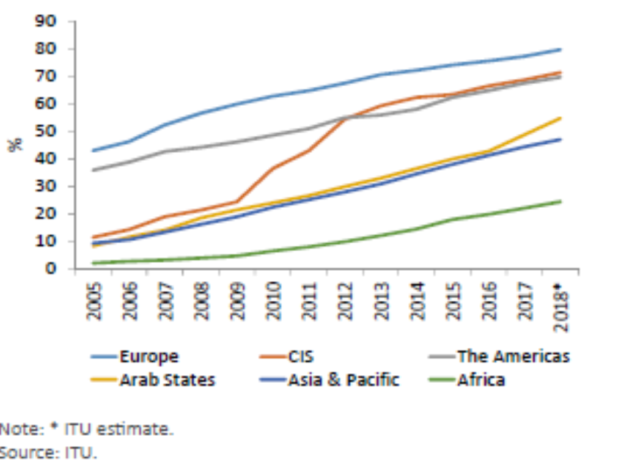

Slide 4
Challenges specific to Africa
  Infrastructure- Backhaul and last mile connectivity
  Price/ affordability- End user charges and cost of access devices (Smart phones, computers etc)
  Digital skills
But
  Fastest growing internet market primarily due to mobile technology advances
  Large Youth population – “tech-tuned”
And
  “Chew gum and talk”
We need to address consumer protection concerns of privacy, trust and security in parallel with challenges that are specific to Africa that remain barriers to an ever-expanding digital economy

Slide 5
Objectives of the Forum
Share experiences and improve knowledge on requirements for securing consumer privacy, trust and security;
improved collaboration and identify critical areas for policy and regulatory harmonization-
Strengthened relations and collaboration between national consumer associations, regional, international organizations and entities involved in consumer protection and use of digital services in Africa

Slide 6
Issues
Exploring the importance of data in the digital ecosystem and the need for data protection, privacy laws and regulation to ensure online security and trust
What online data protection and privacy means for consumers (individuals and businesses), for digital identity
Business models-
Examining exemplar models of ensuring protection, privacy and trust e.g. GDPR and its implications for European consumer
Security measures to ensure privacy and protect data:
Good approaches to enhancing consumer trust and security through data protection
  What are the key factors to promote online innovation and growth?
  What must be avoided
  Where can Government and regulators play an important role?

Slide 7
Questions
Key questions for policy and regulators, empowering the economy:
How do we promote privacy and security throughout the value chains of the digital economy.
How do we keep up with the evolving technological advances of the ICT industry
How do regulators ensure they provide a solid framework without stifling digital/data growth?
How to help guide ICT companies in reaching markets with different privacy and security legislation
How do regulators define success in terms of data protection and communicate this to the public/consumers to promote trust in the digitize economies?
How to ensure and secure the infrastructure to supports the digital economy

Slide 8
Outcome
A draft white paper on national & regional regulatory consumer framework for securing data, consumer privacy and trust in digital Africa
Harmonized approaches for consumer protection in respect to consumer privacy, trust
  National frameworks
  Regional Frameworks

Slide 9
Thank you and Good Luck
anne.rita.ssemboga@itu.int

